Slide 1
Analysing Memory With SDSF for z/OS 2.5
Rob Scott
Rocket Software
rscott@rocketsoftware.com
SDSF Commands and Memory. Do they know things? What do they know? Let’s find out.

Slide 2
New Memory Functions In SDSF for z/OS 2.5
z/OS 2.5 SDSF introduced new displays and functions to help investigate memory usage
New displays for both traditional 24/31-bit memory and 64-bit memory objects
Address space level and system level displays
New facility to allow memory browse of common storage and private storage of any address space.

Slide 3
Topics Covered
Browsing Memory
Browsing memory basics
Mapping control blocks
Point-and-shoot access
Address space diagnostics
Common Storage Analysis
Orphaned (or “owner gone”) storage
Subpool/key summary and details
Address space usage summary and details
Private Storage Analysis
Address space usage summary and details
Subpool/key summary and details
64-bit Memory Objects
Address space usage summary and details

Slide 4
Browsing Memory
Using the new “MEM” and “AD” commands

Slide 5
Browsing Memory
New primary command “MEM”
Syntax :
MEM address {asid} {sysname}
Defaults : address = 0, asid = user address space (hex), sysname = local system
Leading zeroes can be omitted from address and asid
Underscore (“_”) can be used to separate high-half and low-half of address
Examples
MEM 7FCE8
Display the memory contents at address 0x0007FCE8 in your own address space on the local system.
MEM 50_48CA000 CD
Display the contents of storage within a 64-bit memory object owned by ASID 0x00CD starting at address 0x000000500048CA000.
MEM 01E00EAC 00AB SYSA
Display memory contents at address 0x01E00EAC in ASID 0x00AB on remote system SYSA.

Slide 6
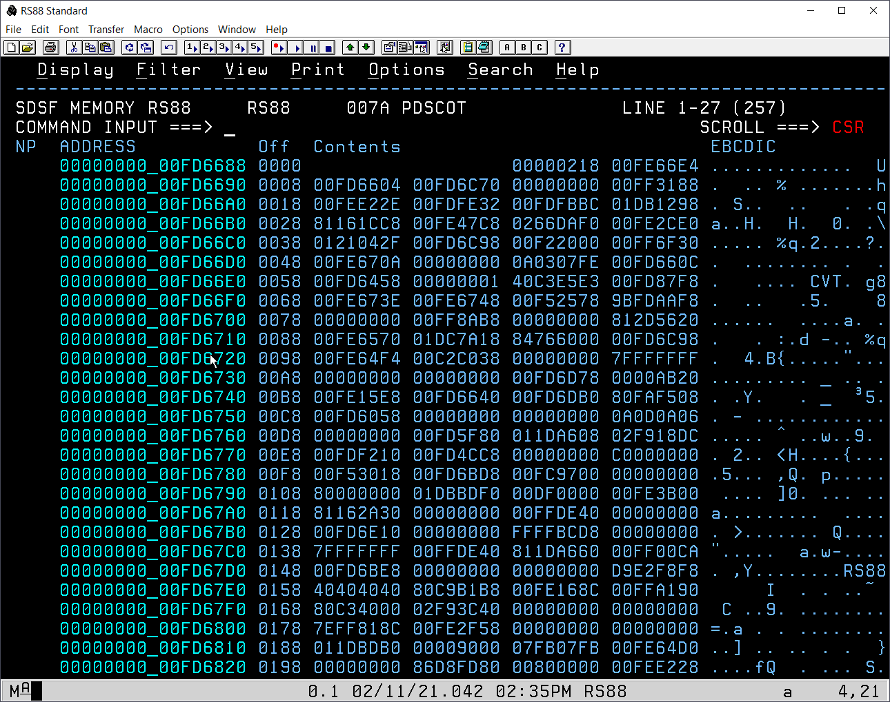
Browsing Memory – Panel
Actions (NP)
D{n}
Show memory at (n)th word of the “Contents” column (1-4) treating it as 31-bit address.
G{n}
Show memory at (n)th word of the “Contents” column (1-3) treating it and the (n+1)th word as a 64-bit address.
M
Show memory mapped to a known structure.
S
Show memory starting at the value in the “Address” column.

Slide 7
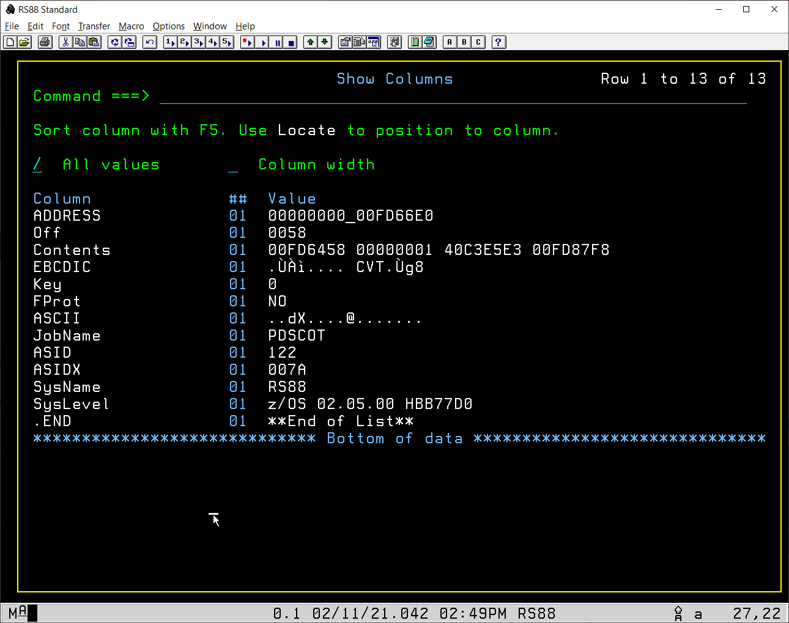
Browsing Memory - Columns
Note the columns not shown on the previous screen shot :
Key
Storage protection key
FProt
Whether fetch protection is in effect
ASCII
Memory contents shown in ASCII rather than EBCDIC

Slide 8
Browsing Memory - Security
Ability to show memory for address space protected by SAF profile in SDSF class
ISFJOB.STORAGE.owner.jobname.sysname
READ access required
Where owner cannot be derived (e.g. some system address spaces), SDSF uses “++++++++”
When page has never been referenced, MEM might show “STORAGE SKIPPED” message and display the next valid storage contents
CONTROL access to ISFJOB.STORAGE.owner.jobname.sysname will allow SDSF to “touch” the target page to differentiate between unreferenced storage and unavailable storage.

Slide 9
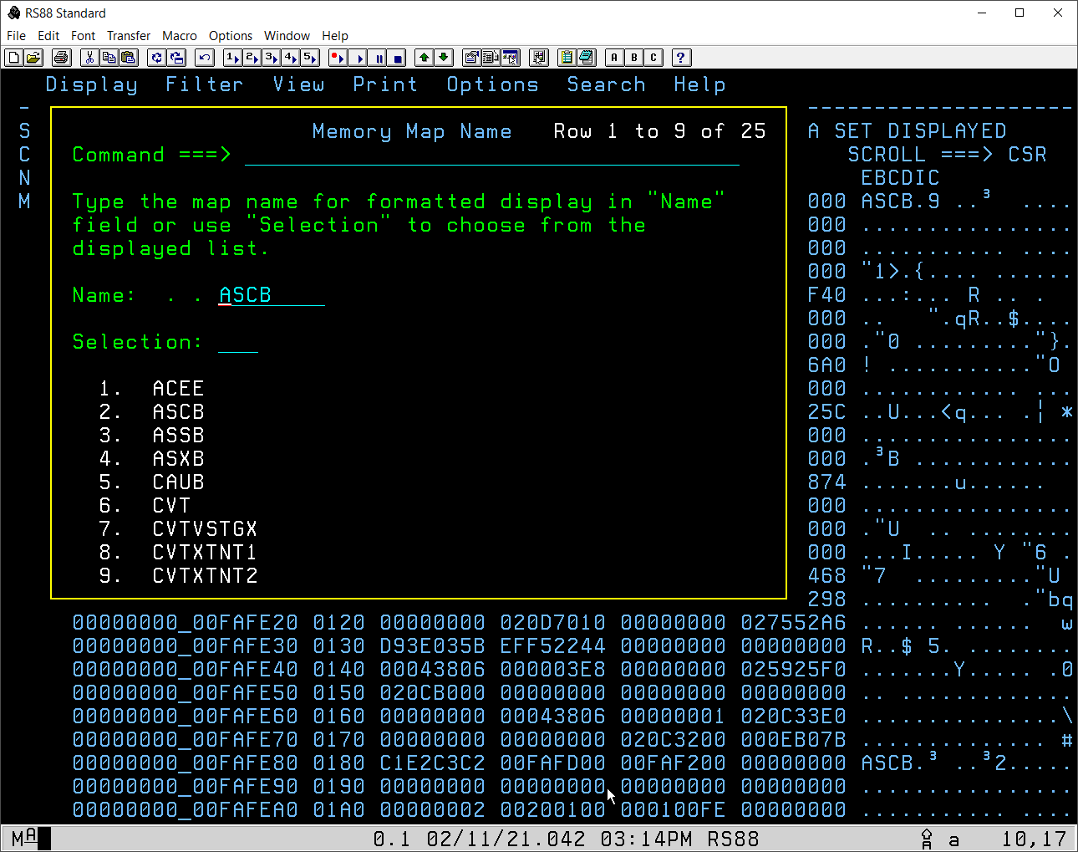
Browsing Memory - Structures
Type “M” beside row that contains the start of the candidate structure
SDSF will examine up to 16 bytes of the storage for a known eye-catcher and if found prime the default structure name in the prompt panel
SDSF prompt panel shown
Select from scrollable list and press enter

Slide 10
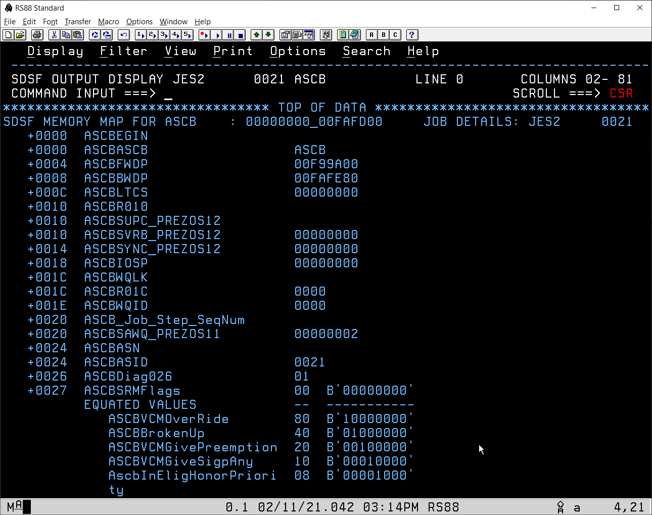
Browsing Memory - Structures
Set PFKey to “MEMCSR”
Position your cursor over an address in the structure display and press the PFKey to invoke MEM using the address at the cursor.

Slide 11
Address Space Diagnostics
New primary command “AD”
Shows identification and diagnostic information about each active address space
Intended as a launch pad for memory problem investigations
Actions include storage related displays for the address space
Common storage usage
Private storage usage
Memory objects
Important control block addresses for each address space shown and enabled for point-and-shoot to invoke the MEM panel

Slide 12
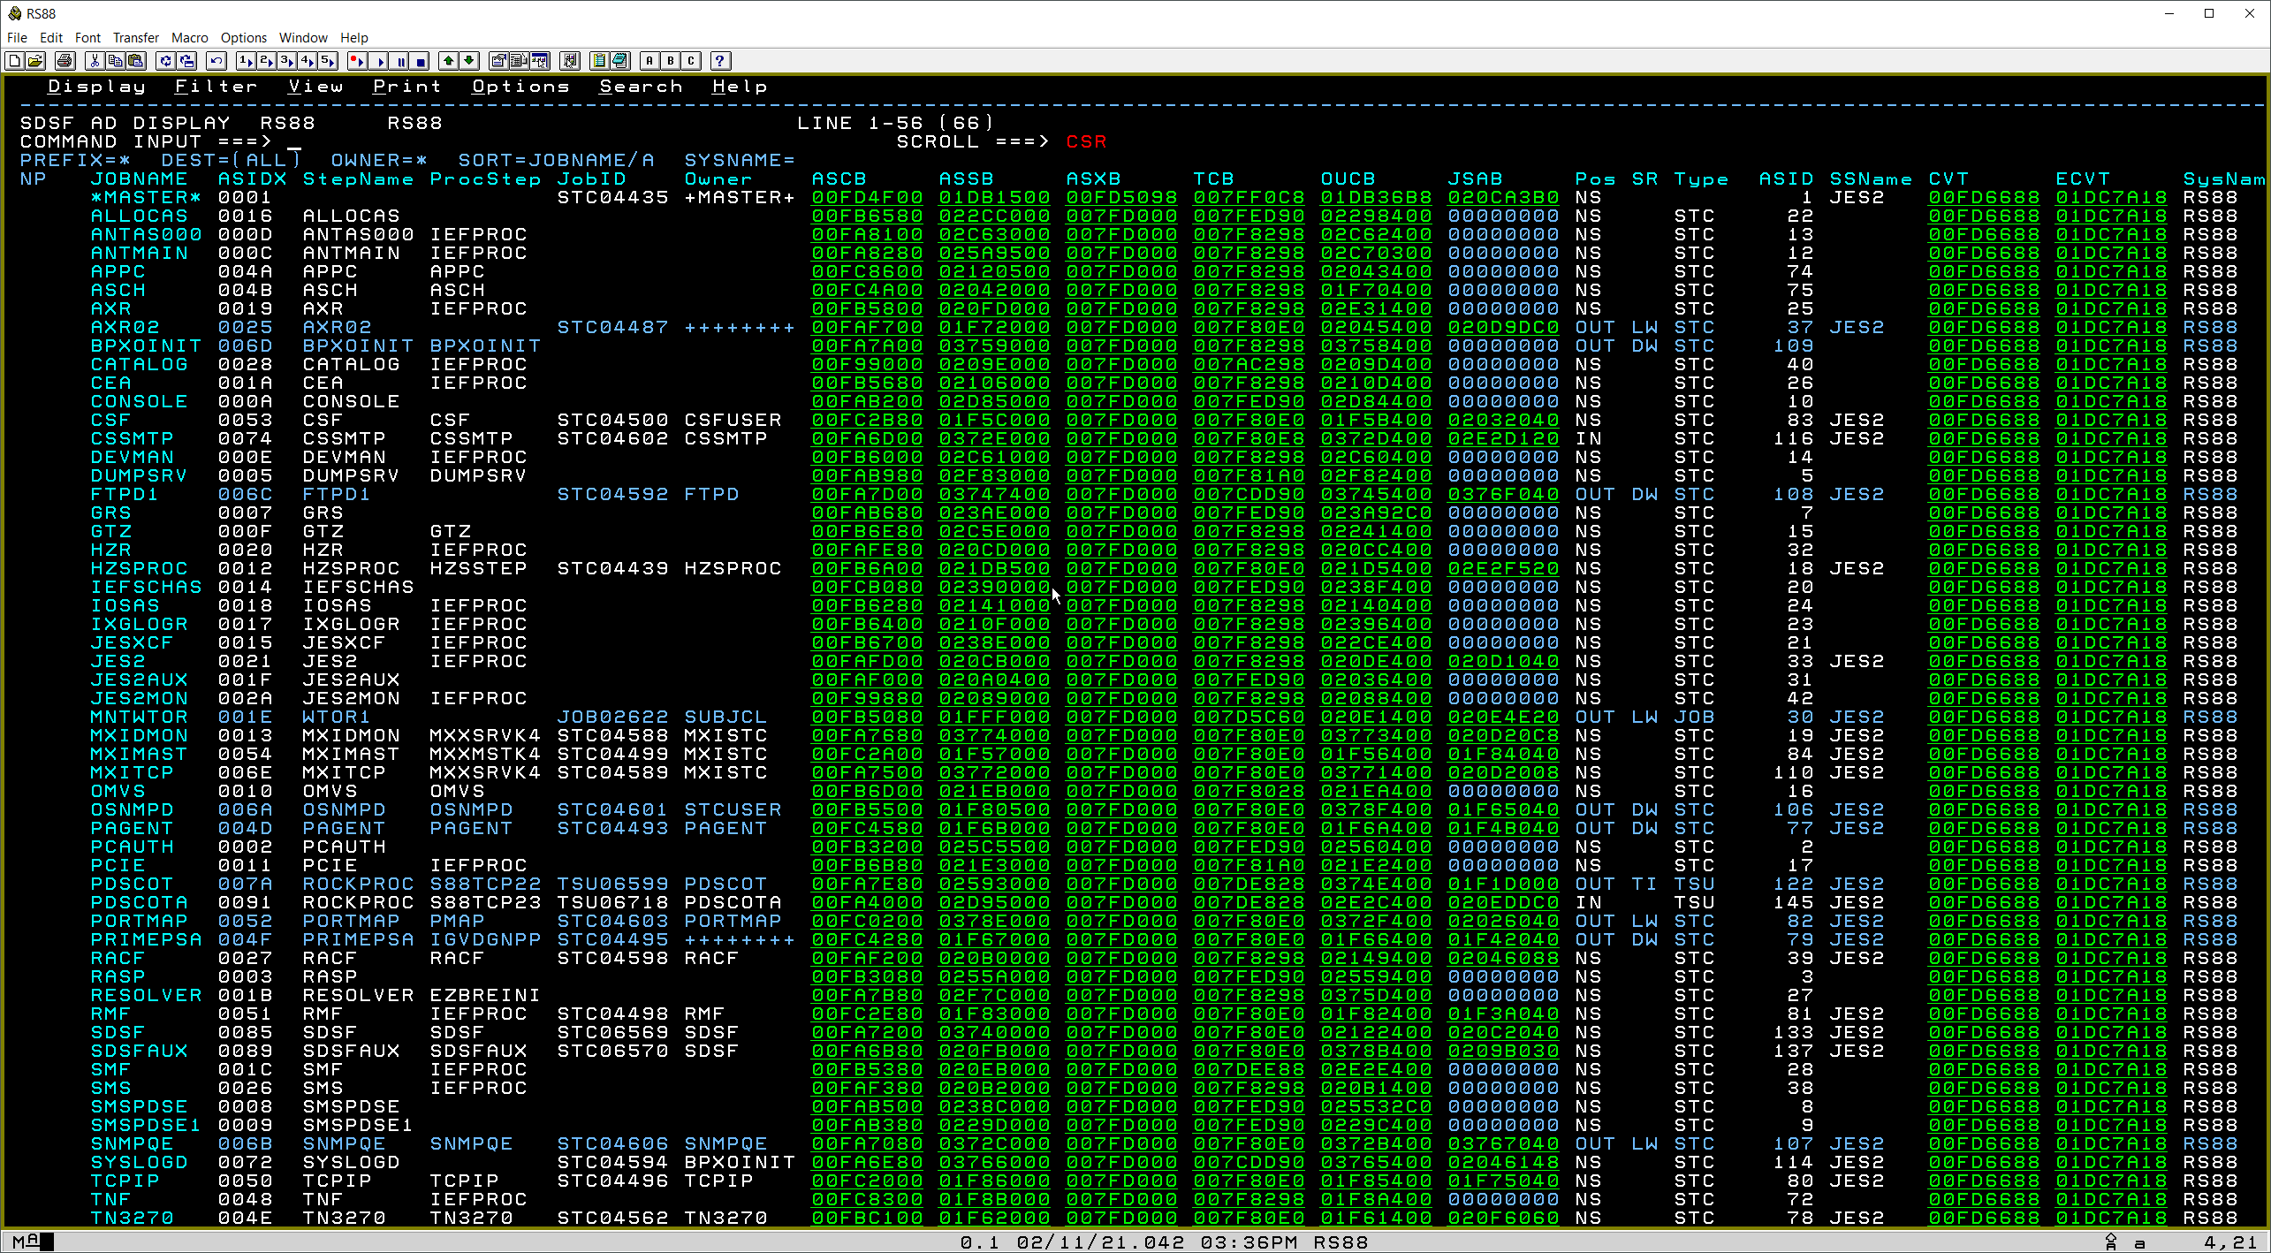
Address Space Diagnostics

Slide 13
Common Storage Analysis
Using the new “CS” command and the “JCS” action

Slide 14
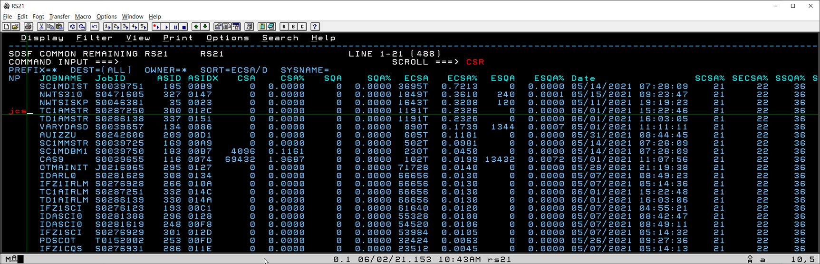
Orphaned Common Storage Analysis
SDSF “CSR” command (Common Storage Remaining)
Available since z/OS 2.3
Displays summary of all known orphaned (aka “Owner Gone”) common storage at the address space level
z/OS 2.5 introduces the “JCS” action to show detailed information about each block of common storage that was owned by the address space

Slide 15
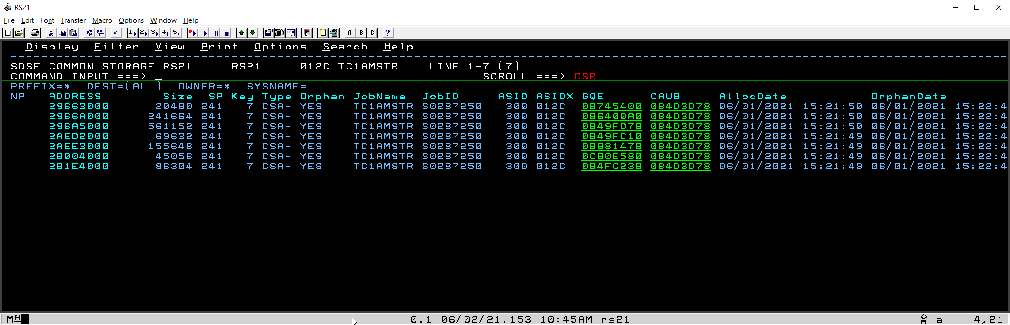
Orphaned Common Storage Analysis – Details
Each block of orphaned common storage shown, including size, subpool and key
Datetime shown when allocated and orphaned
User can select “Address” to invoke the MEM display for the memory
User can point-and-shoot on the GQE or CAUB fields to show the z/OS control blocks that describe this entry

Slide 16
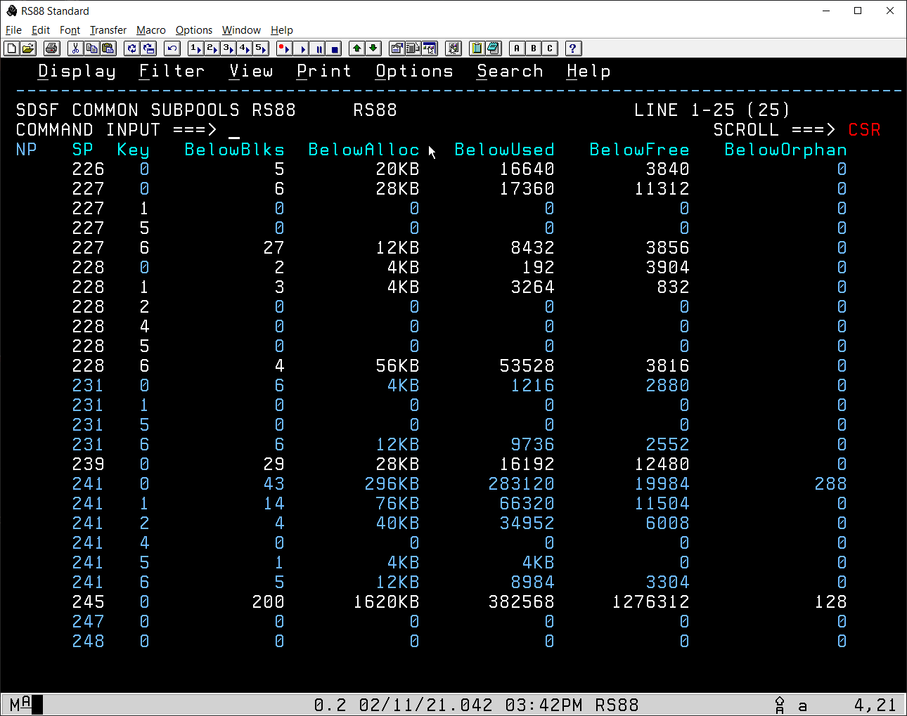
Common Storage Subpools
New “CS” command shows common storage summarized by subpool number and key.
The “L” action on the row drills down to show every block of storage with the same subpool number and key.

Slide 17
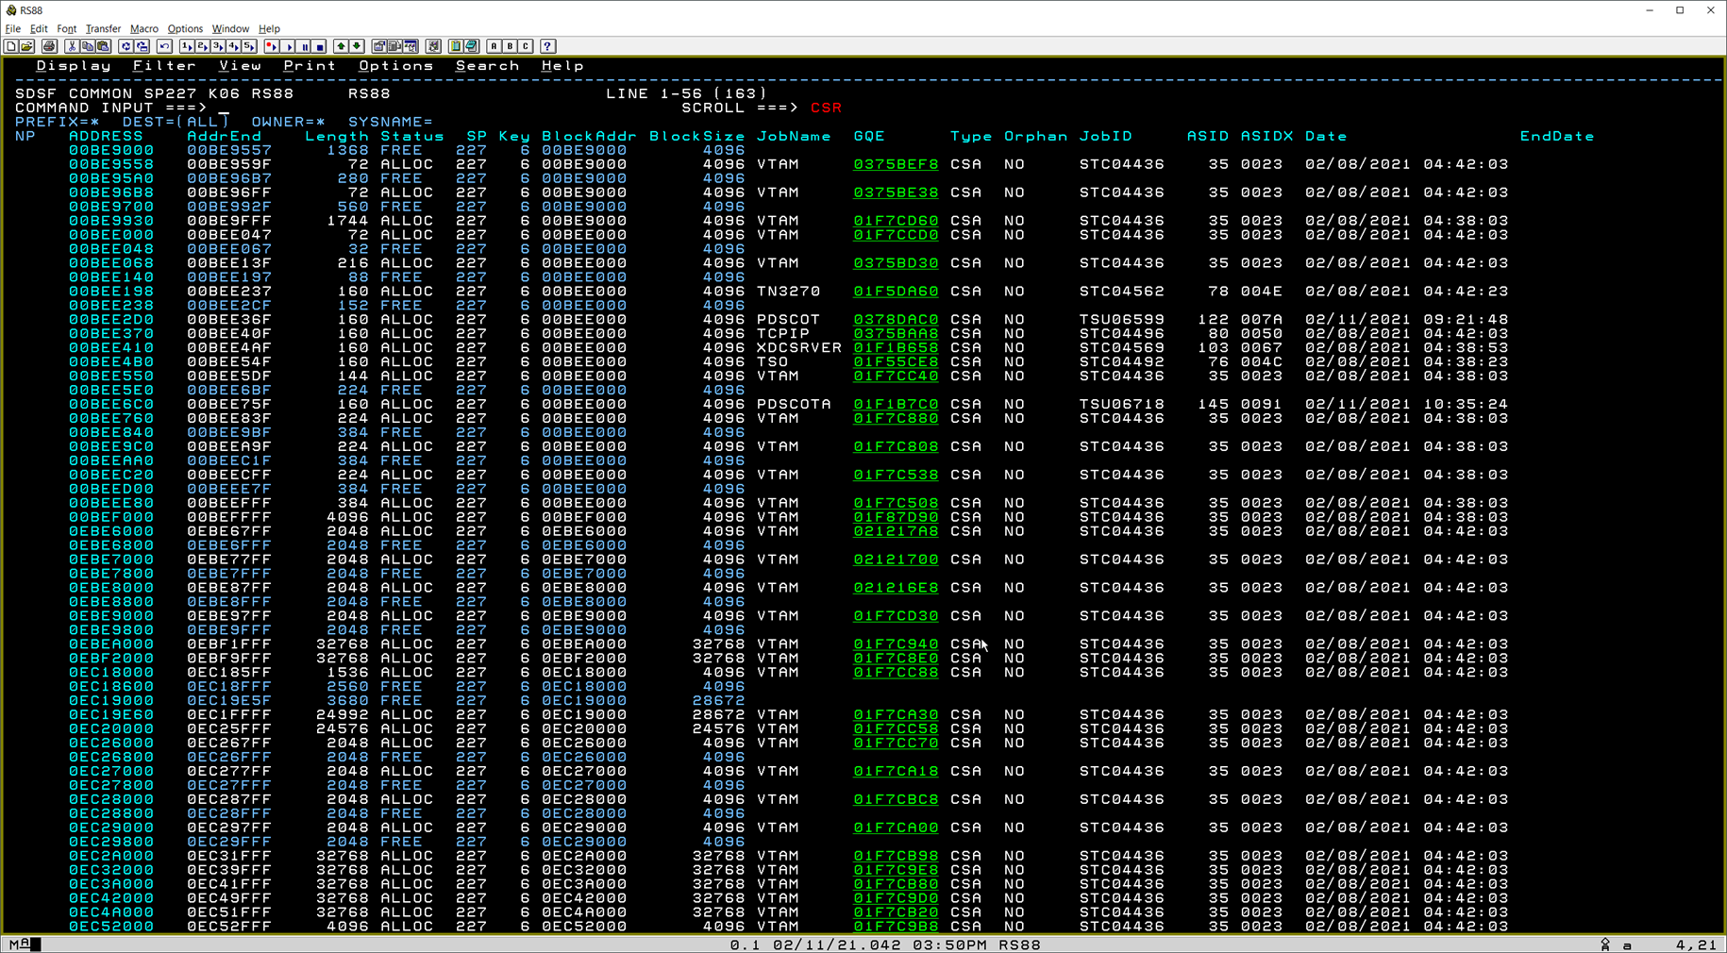
Common Storage Subpools - Details

Slide 18
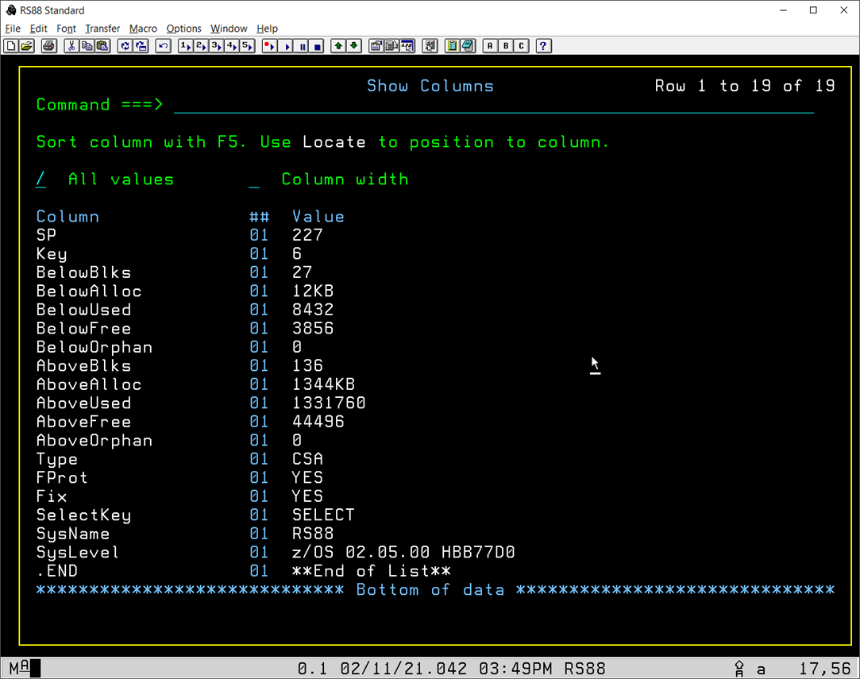
Common Storage Subpools - Columns
Note columns not shown on previous screens :
FProt
Whether fetch protection applies
Fix
Whether the memory is fixed
SelectKey
The storage key selection method used (0 or “SELECT”)

Slide 19
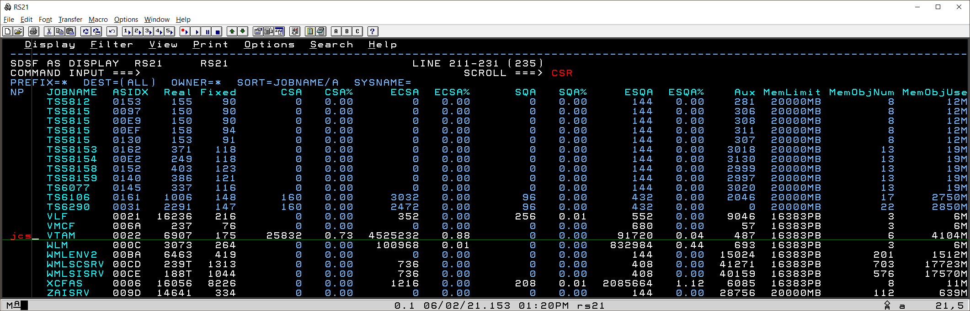
Common Storage By Jobname
SDSF “AS” command
Available since z/OS 2.2
Displays summary of memory usage at the address space level including common storage
z/OS 2.5 introduces the “JCS” action to show detailed information about each block of common storage that is owned by the address space

Slide 20
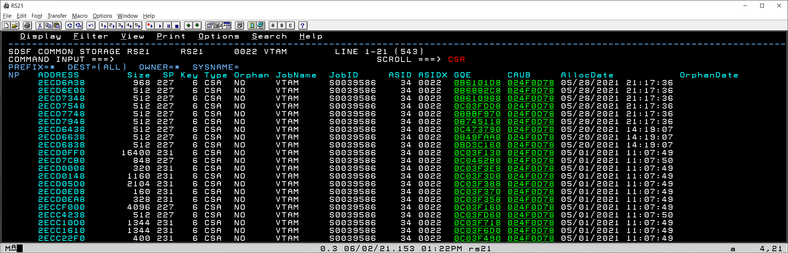
Common Storage By Jobname - Details
“JCS” action available on “AS”, “AD”, “DA” and “CSR”

Slide 21
Private Storage Analysis
Using the new “L” action on the “JM” display

Slide 22
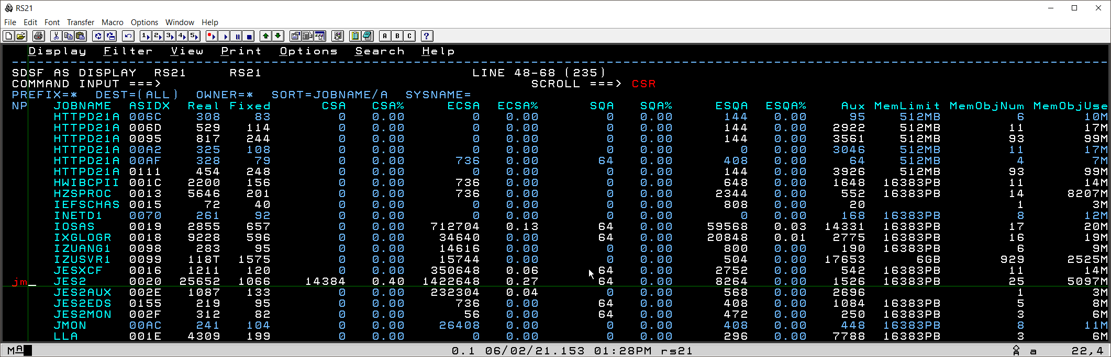
Private Storage Analysis
“JM” action to show “Job Memory”
Available since z/OS 1.12
Shows summary of private storage usage by subpool and key
Available from “AD”, “AS” and “DA” panels

Slide 23
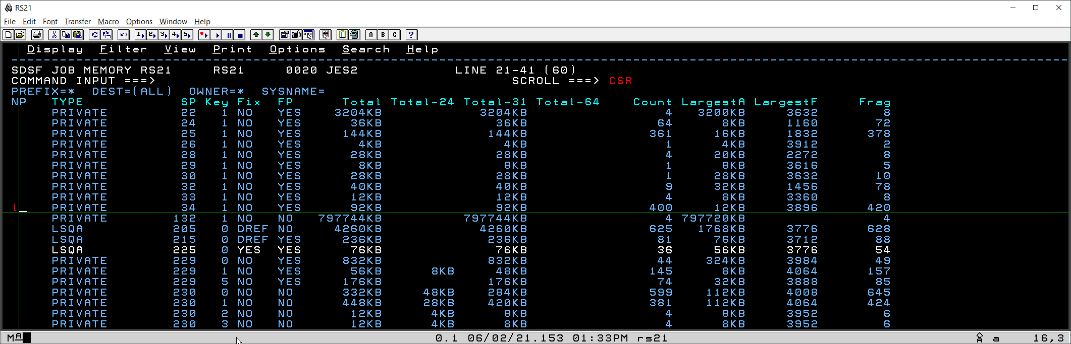
Private Storage Summary
New “L” action against row will drill down to show each block for a subpool number and key combination

Slide 24
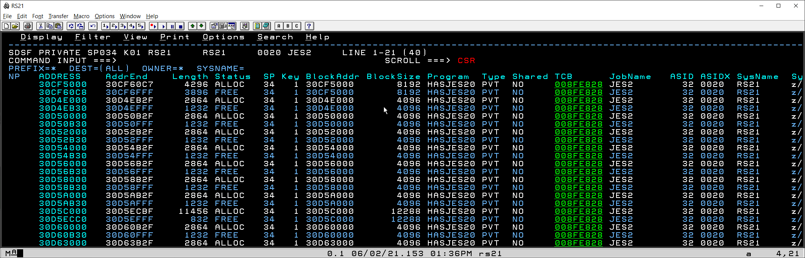
Private Storage Details
User can select “Address” to browse the memory
Program name from top RB for the TCB is shown

Slide 25
64-bit Memory Objects
Using the “JMO” action and new columns on “AS”

Slide 26
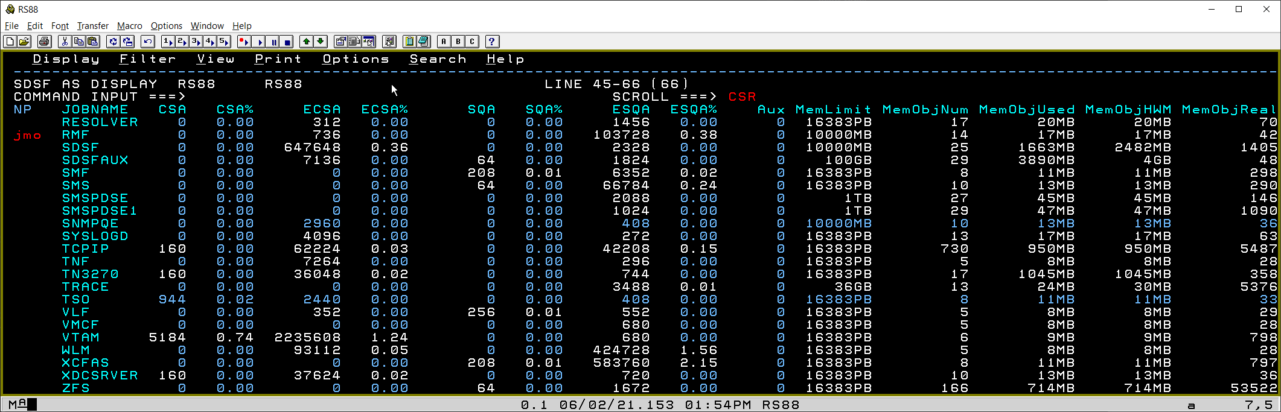
64-bit Memory Objects Summary
New “MemObjReal” column on “AS” shows number of real frames backing 64-bit memory objects
Also “MemObjAux” column for auxiliary storage slots
“JMO” action to show “Job Memory Objects”
Available since z/OS 2.4
Shows summary of memory objects owned by address space

Slide 27
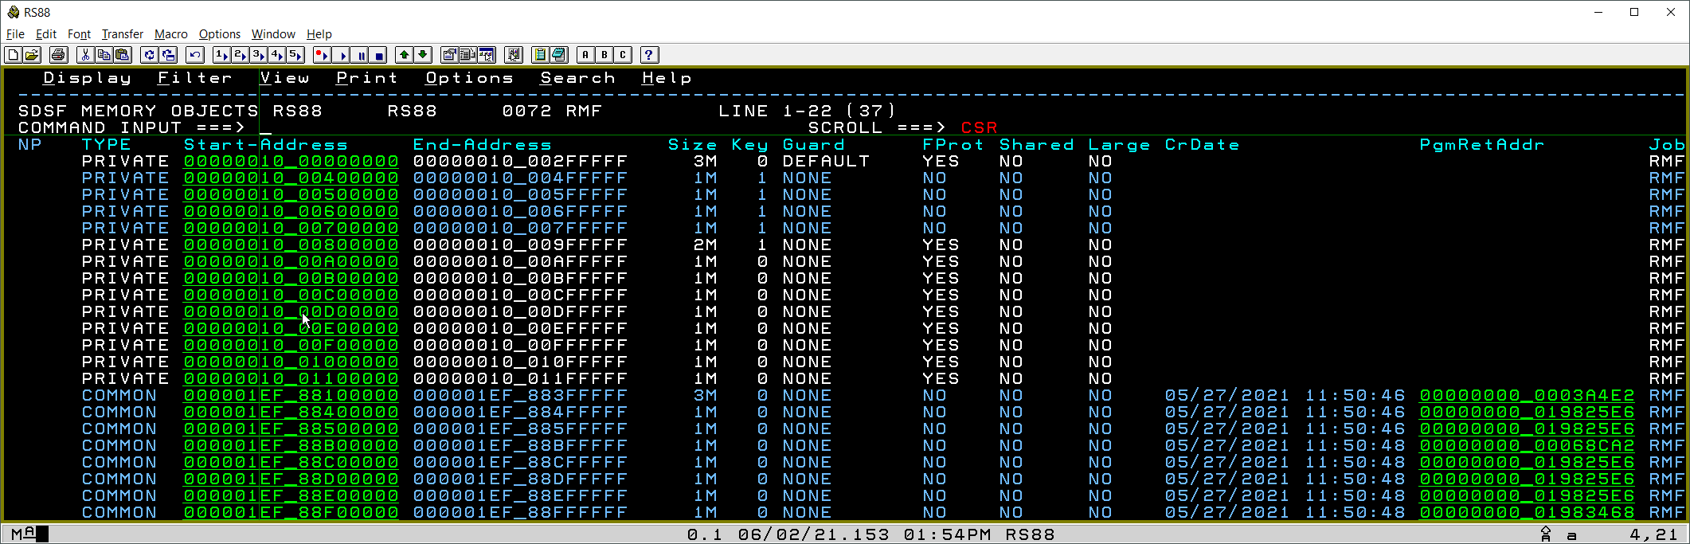
64-Bit Memory Objects - Details
HV-Common (64bit common) memory objects show creation datetime and return address of creating program

Slide 28
Miscellaneous Information

Slide 29
Additional Points Of Interest
Point-and-shoot memory addresses are green and underscored by default.
This can be changed from the “SET SCREEN” options dialogue
Option exists to use CUA attributes instead of SDSF attributes
Common storage is considered owned by *MASTER* ASID 0x0001 for the purposes of authorization to browse it.

